Slide 1
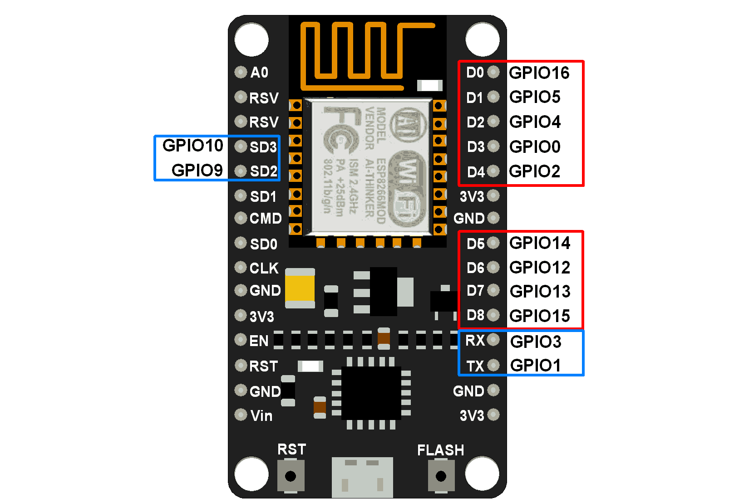


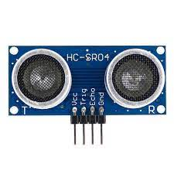

NodeMcu Microcontroller
Cloud Database
Ultrasonic Sensor

Slide 2
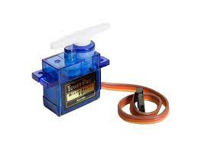
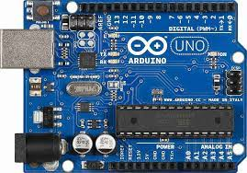
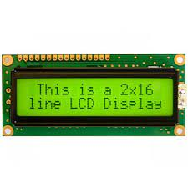
Ultrasonic Sensor
Servo Motor
Ultrasonic Sensors
Cloud Database
Arduino Uno
NodeMcu
16*2 LCD Display

Slide 3
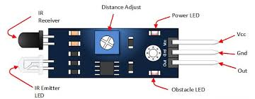
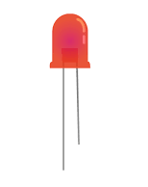
IR Sensor
LED Lights
Arduino Uno

Slide 4
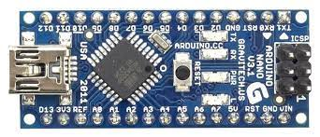
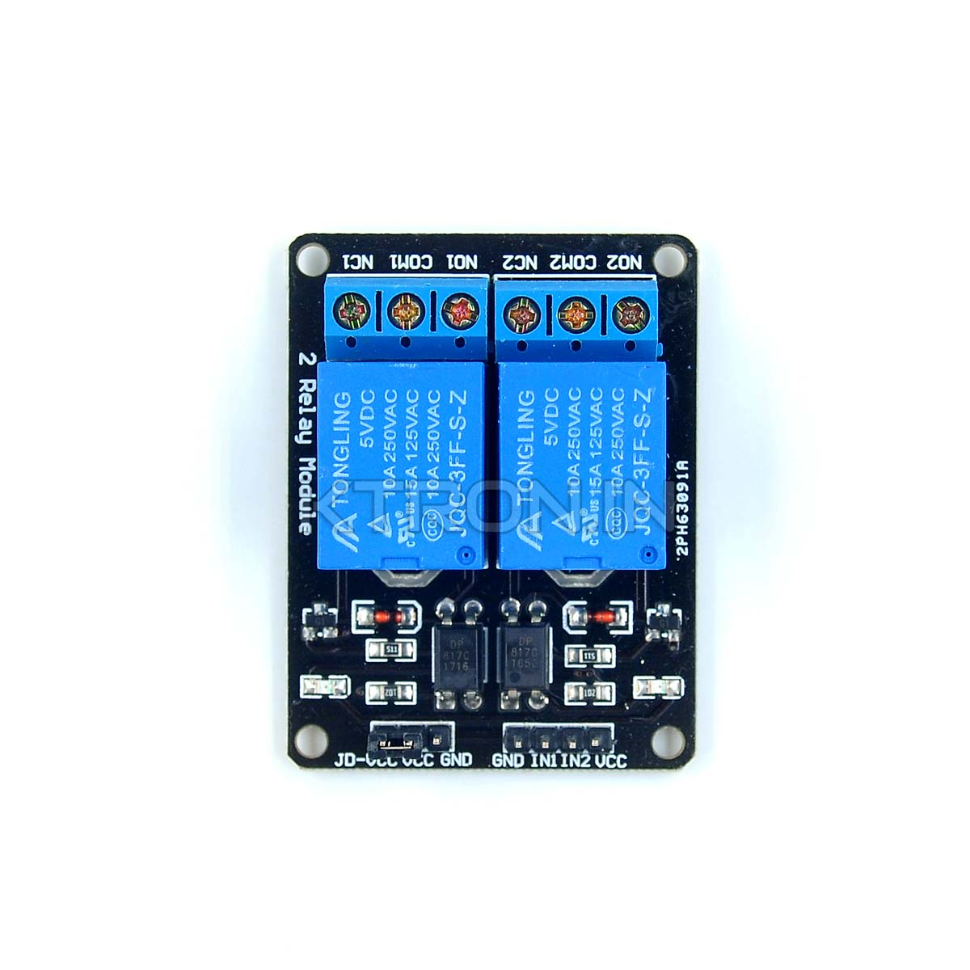
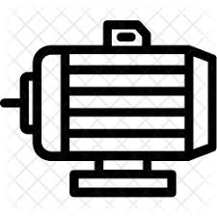
Water Level Sensor
NodeMcu
Cloud Database
Arduino Nano
Relay Module
Water Pump

